Slide 1


A Metaheuristic based Approach for Maximizing Sprint Capacity Utilization using Genetic Algorithm
Nayan Chandra Das (0424052071)
Md. Nazmul Abdal (0424052094)
Ryhan Ahmed Tamim (0424052095)

Slide 2
Overview
Introduction
Methodology
Result
Discussion
Conclusion

Slide 3
Introduction
In software development and project management, efficient resource allocation and task scheduling are critical for maximizing productivity and ensuring timely project delivery.
Agile methodologies, particularly Scrum, are widely used due to their iterative and incremental approach, which promotes adaptability and continuous improvement.
A crucial aspect of Scrum is sprint planning, which involves assigning tasks to team members in a time-boxed manner. However, one of the persistent challenges in sprint planning is optimizing the utilization of team members' capacities while considering constraints such as skill sets, task dependencies, and time limitations.

Slide 4
Motivation
The motivation behind this research stems from the inefficiencies observed in traditional sprint planning methods, which often struggle with complexity and dynamic project environments.
Many conventional scheduling techniques fail to address multiple constraints effectively, making metaheuristic approaches a viable alternative.
Genetic Algorithms (GA), inspired by natural selection and evolution principles, offer a promising solution for optimizing sprint capacity utilization by efficiently exploring large search spaces and converging towards near-optimal solutions.

Slide 5
Objectives
This paper proposes a metaheuristic-based approach to maximize sprint capacity utilization using a Genetic Algorithm.
The problem is defined as follows: Given 7 projects and 200 tasks, each associated with a project and having a defined completion time, the objective is to assign these tasks to 5 team members over a 14-day sprint.
Each team member has a maximum daily capacity and specific project expertise.
The goal is to maximize the utilization of each team member while ensuring skill compatibility and adherence to capacity constraints.
.

Slide 6
Literature Review
Several studies have explored optimization techniques for agile project planning. Researchers have utilized mixed-integer programming models to improve sprint planning by considering objectives such as sprint capacity utilization and user story prioritization.
Metaheuristic methods like the Non-dominated Sorting Genetic Algorithm (NSGA-II) and the Strong Pareto Evolutionary Algorithm (SPEA2) have demonstrated improved performance over traditional optimization techniques.
GA has shown superior performance in similar problems.

Slide 7
Other studies have employed heuristic-based approaches, such as Greedy Heuristic methods, to enhance sprint planning efficiency.
Integer Linear Programming (ILP) models have been proposed to maximize business value while considering development constraints.
Additionally, research has explored context-aware task allocation frameworks that utilize real-time data to improve Agile project planning.

Slide 8
Methodology

Slide 9
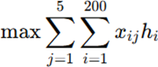
Problem Formulation
The problem is modeled as a constraint-based optimization challenge, where the goal is to maximize sprint capacity utilization while ensuring adherence to project-specific expertise and work-hour limits. The key decision variables are task and workload allocation .The constraints include:
Assigning tasks only to trained members.
Adhering to daily work-hour limits.
Completing all work within the 14-day sprint.
Ensuring each task is assigned to a single qualified member.

Slide 10
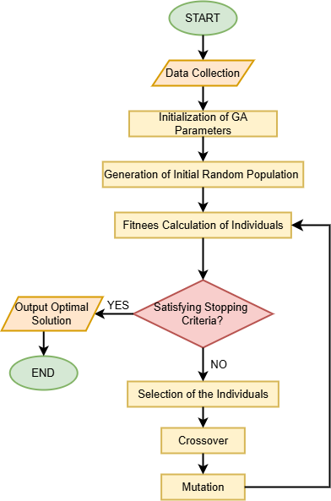
Proposed Method
Initialization: Generate an initial random population.
Fitness Calculation: Evaluate solutions based on total assigned hours.
Selection: Choose parents using tournament selection.
Crossover: Generate new offspring through uniform crossover.
Mutation: Introduce diversity by swapping task assignments.
Termination: Stop when an optimal or near-optimal solution is found.

Slide 11
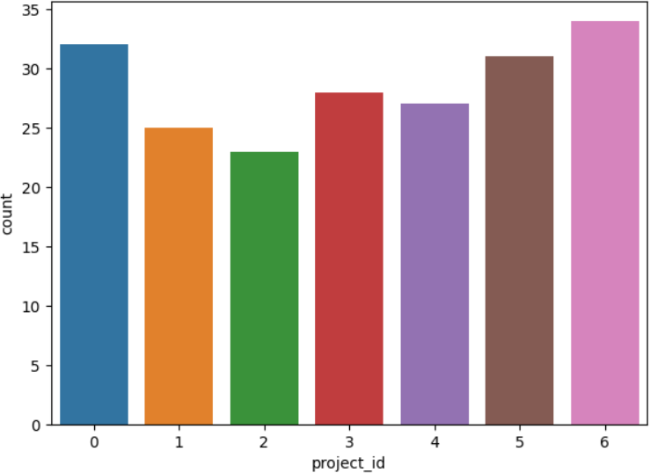
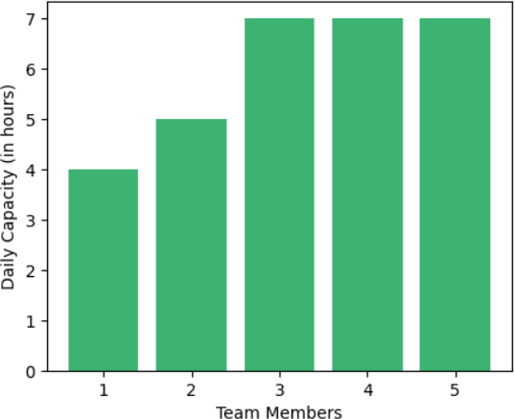
Dataset

Slide 12
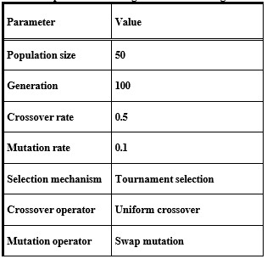
Platfroms
The GA was implemented in Python using NumPy and Pandas, running on an AMD Ryzen 5 system with 8GB RAM. The parameters were:

Slide 13
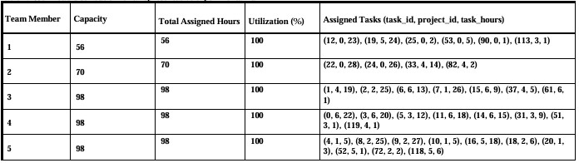
Results
We conducted multiple experimental runs, and the average sprint capacity utilization achieved was 100%, demonstrating the effectiveness of our approach in maximizing team workload while adhering to constraints.

Slide 14
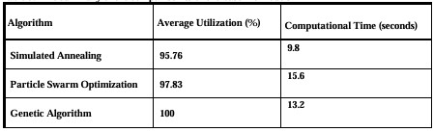
Comparative Analysis
To benchmark the performance of the proposed GA, we compared it with two state-of-the-art methods, including Simulated Annealing (SA) and Particle Swarm Optimization (PSO).
GA achieved 4.24% higher utilization than SA.
GA outperformed PSO by 2.17% in utilization.
Computational efficiency remained within acceptable limits (~13.2s runtime).

Slide 15
Discussion
The high utilization rate of 99.59% across multiple experimental runs highlights GA's capability to optimize task allocation within a structured sprint environment. Key insights include:
Fair workload distribution: GA effectively prevents overloading or underutilization of team members.
Skill-based allocation: GA ensures members work within their expertise, leading to better efficiency.
Comparison with baseline models: GA’s exploration and exploitation mechanisms provide superior optimization over SA and PSO.
Real-world applicability: The proposed method can be integrated into Agile management tools for dynamic task reassignment.

Slide 16
Conclusion
This study demonstrated the potential of Genetic Algorithms in solving complex resource allocation challenges in Agile project management.
By maximizing sprint capacity utilization, organizations can improve productivity, optimize resource use, and enhance project outcomes.
Future work should explore dynamic task prioritization and real-time data integration to further refine the model for practical deployment in agile environments.

Slide 17
References
N. Ozcelikkan, G. Tuzkaya, C. Alabas-Uslu, B. Sennaroglu, A multi-objective agile project planning model and a comparative meta-heuristic approach, Information and Software Technology 151 (2022) 107023.
B. Prakash, V. Viswanathan, A comparative study of meta-heuristic optimisation techniques for prioritisation of risks in agile software development, International Journal of Computer Applications in Technology 62 (2020) 175.
M. Shameem, M. Nadeem, A.T. Zamani, Genetic algorithm based probabilistic model for agile project success in global software development, Applied Soft Computing 135 (2023) 109998.
Jansi, S., & Rajeswari, K.C. (2015). A greedy heuristic approach for sprint planning in agile software development. International Journal for Trends in Engineering & Technology, 3(1), 18-21.
M.A. Boschetti, M. Golfarelli, S. Rizzi, E. Turricchia, A Lagrangian heuristic for sprint planning in agile software development, Computers & Operations Research 43 (2013) 116–128.
K.V. Melnyk, V.N. Hlushko, N.V. Borysova, Decision support technology for sprint planning, Radio Electronics Computer Science Control 0 (2020) 135–145.
Kula, E., Van Deursen, A., & Gousios, G. (2024). Context-aware automated sprint plan generation for agile software development. Proceedings of the 39th IEEE/ACM International Conference on Automated Software Engineering, 1745-1756.

Slide 18
J. Lin, "Context-aware task allocation for distributed agile team," in Proceedings of the 28th IEEE/ACM International Conference on Automated Software Engineering (ASE), Silicon Valley, CA, USA, 2013, pp. 758–761.
Y.J.P. Castillo, S.D.O. Jiménez, P.O.L. Torres, Sprint Management in Agile Approach: progress and velocity evaluation applying Machine learning, Information 15 (2024) 726.
M. Golfarelli, S. Rizzi, E. Turricchia, Multi-sprint planning and smooth replanning: An optimization model, Journal of Systems and Software 86 (2013) 2357– 2370.
A. Anand, J. Kaur, O. Singh, M. Ram, Optimal Resource Allocation for Software Development under Agile Framework, Reliability: Theory & Applications (2021).
A. Anand, J. Kaur, O. Singh, O.H. Alhazmi, Optimal sprint length determination for Agile-Based software development, Computers, Materials & Continua/Computers, Materials & Continua (Print) 68 (2021) 3693–3712.
Nayan Chandra Das. (2025). Metaheuristic Project [GitHub repository]. Available at: https://github.com/NC-Das/Maximize-Sprint-Capacity-Utilization

Slide 19
THANK YOU

